Slide 1
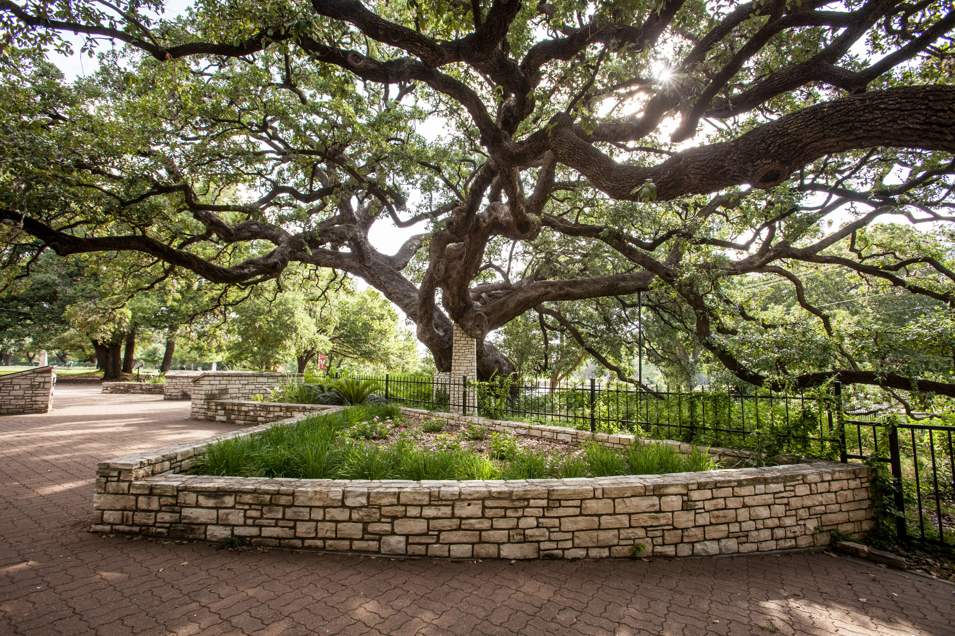
CDBG Application Workshop
February 11, 2025 @
2:30 PM
Tejas Room – City Hall

Slide 2

WELCOME & AGENDA
Welcome to the City of New Braunfels’ CDBG Program
Year 2025 Application Workshop
CDBG Program Support Staff: Jennifer Gates, Grants Coordinator, and Paula Harper, CDBG Consultant
Agenda:
CDBG Overview
Application Process
Post-Award Contract Requirements
Questions & Answers

Slide 3
What is CDBG?
Community Development Block Grant (1974).
Federal program funded through non-competitive grants to cities, counties, and states.
Purpose is to reduce poverty and its effects, and develop viable communities by:
  Providing decent housing
  Creating a suitable living environment
  Expanding economic opportunities

Slide 4
National Objectives
All programs must meet a HUD National Objective:
Benefit Low- to Moderate-Income persons/households.
Aid in the prevention/elimination of slum and blight.
Meet an Urgent Need.
  This is rarely utilized because it is associated with natural and/or manmade disasters.

Slide 5
Funding and Funding Caps
CDBG funds are dependent upon the annual amount of funding allocated to the City by HUD.
Program Year 2025 (PY25) Estimated Funding Distribution:
Based upon Program Year 2024 Grant: $495,919
Public Service (15% cap): $74,388
  CDBG funding for Public Services must be for a new service or a measurable increase in the level of service.
Planning & Administration (20% cap; for City use only): $99,184
Other Activities: $322,347

Slide 6
Definitions
Low- to Moderate-Income are residents whose household income is equal to or less than 80% of the area’s household median income for that household size.
CDBG Target Areas that are primarily low- to moderate-income are Census Block Groups where 43.90% or more households are low- to moderate-income.
Presumed Benefit/Limited Clientele are those who are presumed by HUD to be low- to moderate-income based on their situation.

Slide 7
Presumed Benefits
Presumed Benefit/Limited Clientele are:
  Severely disabled
  Elderly (at least 62 years of age)
  Victims of domestic violence and sexual assault
  Abused and/or neglected children
  People experiencing homelessness
  Illiterate adults
  Migrant workers
  Persons living with AIDS

Slide 8
Beneficiaries
Most common objective for Public Services is support for low- and moderate-income persons.
Public facilities, including infrastructure, must guarantee benefit to at least 70% low- and moderate-income persons.
Housing activities must serve 100% low- and moderate-income clients.

Slide 9
2024 Income Limits
Household Size | Annual Household Income
1 Person | $49,600
2 Persons | $56,650
3 Persons | $63,750
4 Persons | $70,800
5 Persons | $76,500
6 Persons | $82,150
7 Persons | $87,800
8+ Persons | $93,500
NOTE: 2025 income limits have not yet been released by HUD. Income limits will be updated by October 1, 2025.

Slide 10
Eligible Applicants
Existing 501(c)(3) or other non-profit status.
Other Public Agencies.
For-Profits with mission to serve low-income persons/families.
City Departments.
Community-Based Housing Organizations (CBHO).
Community Housing Development Organizations (CHDO).
NOTE: Applicants on the Federal or State de-barred list are not eligible to apply for or receive CDBG funds.

Slide 11
Public Services Examples
Senior services
Children and Youth services
Services for abused and/or neglected children
Healthcare, including mental healthcare
Homeless services, and homelessness prevention
Educational and job training services
Transportation assistance
Food assistance
Salaries but only for staff time spent working directly with clients including intake, client staffing, developing service plans, entering client notes.
  Administrative costs even for staff working directly with clients are not eligible e.g., CDBG reporting, staff meetings, trainings, travel.

Slide 12
Public Services – Rental Assistance
Emergency Rent and Utility assistance is a public services (not housing) activity and is designated by HUD as Homeless Prevention.
Rent and utility assistance cannot exceed 3 months during a program year but does not have to be consecutive months.
The 3-month limit is inclusive for rent and utility assistance.
An eligible applicant cannot receive 3 months of rental assistance and an additional 3 months of utility assistance.
However, if both are provided at the same time, it is counted as one month of assistance.

Slide 13
Housing Activities Examples
Must benefit low-moderate income households.
Owner-occupied minor home repair must be within the city limits, must be the primary residence, and repair projects cannot exceed $10,000 per project.
Income must be documented by a third-party source.
Accessibility modifications for disabled household members.
Energy-efficiency improvements.
Homebuyer assistance provides downpayment and closing costs.
Repairs for rental property are NOT eligible.

Slide 14
Public Facilities & Area Based Activities
Repair or installation of infrastructure e.g., streets, sidewalks, public parking, water lines, sewer lines, drainage.
Acquisition, construction or rehabilitation of public facilities e.g., neighborhood/community facilities and facilities for special populations such as domestic violence, homeless and transitional housing.
Development or improvements to public parks.
Historic preservation.
Clearance or demolition (Subject to one-on-one housing replacement regulations).
Salaries for code enforcement officers working in low-mod areas.

Slide 15
Ineligible Activities
Ineligible Activities
Buildings used for the general conduct of government.
General government expenses.
Political activities.
Generally Ineligible Activities, Some Allowable Exceptions
Purchase of equipment; may be eligible if part of a public services grant.
Operating and maintenance expenses; may be eligible if part of a public services grant.
Construction of new, permanent residential structures.
Direct Income Payments.

Slide 16
New Applicants/New Activities
First time applicants MUST submit a description of the requested activity by email and/or schedule a meeting with CDBG Program Support Staff prior to the submission date.
Previously funded agencies requesting funds for a new activity are encouraged to submit a description of the activity via email to CDBG Program Support Staff.

Slide 17
Application Overview
Three (3) separate applications are available for Public Services, Public Facilities, and Housing activities.
  If applying for multiple activities, a separate application must be submitted for each requested activity.
  Funds may only be used for persons residing within New Braunfels’ city limits or for HUD designated low-moderate census tracks within the city limits.

Slide 18
Application Overview
Agencies requesting CDBG funds for salary costs must submit a job description for each position.
Agencies must submit most recent management letter for audit.
All information provided should be as complete as possible e.g., itemized and accurate budget, realistic timeline/schedule, and proportional number of beneficiaries to funding request.
Applications may be submitted as hardcopies or electronic.
Incomplete applications may result in disqualification.

Slide 19
Application Details
SECTION 1 – GENERAL INFORMATION
  Overview of agency
  Overview of funding request
  Overview of activity and associated beneficiaries
SECTIONS 2 – APPLICATIONS, including supplemental information such as quotes and job descriptions
  Application for Public Services
  Application for Public Facilities
  Application for Housing

Slide 20
Application Details
SECTION 3 – CERTIFICATIONS
  Provide the signed certifications with the one complete, original application, and the electronic version of the complete application.
SECTION 4 – ATTACHMENTS
  Provide the required attachments with the one complete, original application, and the electronic version of the complete application.

Slide 21
Submission of Application
Hardcopy or Electronic Applications will be accepted until March 11, 2025, no later than 4:00 PM (local time). Applications submitted after the deadline will not be accepted.
  HARDCOPY: Submit one complete, original application with all certifications and attachments, and an electronic copy of the complete application on a USB device.
    Additionally, applicants are to submit 10 abridged (Sections 1 and 2 only) hardcopies with their full hardcopy and electronic application. Please do not use tabs or bind/staple the complete application or its abridged copies. Hardcopies must be delivered in a sealed application packet to the City Secretary’s Office at the New Braunfels’ City Hall.
  ELECTRONIC: Submit one complete, original application with all attachments via email to CDBG Program Support Staff. Staff will provide confirmation of receipt of the application.

Slide 22
Application Review/Ranking
All applications will be reviewed for completeness and HUD-eligibility. Please ensure that your application:
  Application narrative contains a well-defined description of the project/program (“activity”).
  Application has relevant, clear outcomes and measurements for activity.
  If not previously funded by CDBG, ensure that requested activity is not duplicating a service.
  If previously funded by CDBG, Public Service activities must show increased demand in the level of service.
  Project readiness, or delivery plans, for activity are timely and realistic.
  Organization/staff has strong experience and capacity to manage activity.
  Proposed activity budget leverages funds other than CDBG funding.
  Number of New Braunfels’ beneficiaries is proportional to funding request.

Slide 23
Application Review/Ranking
After the initial screening process for HUD-eligibility, the Community Development Advisory Committee (CDAC) will review, and rank applications based upon multiple factors.
CDAC Meeting Schedule:
  April 2, 2025: Review and discussion of applications – Tejas Room at 6:00 PM.
  May 7, 2025: Ranking and funding recommendations – City Council Chambers at 6:00 PM
If additional info is needed, applicants will be contacted via email by CDBG Support Staff to submit additional documentation and/or respond to clarifying questions within a certain timeframe.
Failure to submit additional information may result in disqualification or a reduction of the funding request.

Slide 24
Post-Award: Reporting
Reports are submitted monthly, with or without a reimbursement request.
Records/Reporting
  Number Served
  Ethnicity and Race
  Household Income
  Number of Persons in Household
  Number of Female-Headed Household
  Number of Elderly or Disabled
  Other information depending on program
Monitoring of activities by CDBG Program Support Staff will occur at least once per year.

Slide 25
Post-Award: Expenditures
Grant awards are dependent upon the amount of funding allocated to the City by HUD. CDBG staff will notify all recommended/awarded subrecipients in writing with updates pertaining to the availability and amount of funding as quickly as possible.
Anticipated contract period will be October 1, 2025, through September 30, 2026.
CDBG is a reimbursement program. Reimbursement requests must be submitted in a timely manner.
Programs that are not expending funds in a timely manner could be subject to contract cancellation.
Unexpended funds at the end of the contract period will be recaptured by the City.
Contract term dates will not be extended.

Slide 26
Timeline
NOTE: Timeline is subject to change; updates will be provided by email & on City’s CDBG website.
ACTIVITY | ANTICIPATED DATE
Application Workshop & Applications are Available | February 11, 2025 @ 2:30 PM – Tejas Room
Application Submission Deadline | March 11, 2025, by 4:00 PM CST
CDAC – Review and Discussion of Applications | April 2, 2025 @ 6:00 PM – Tejas Room
CDAC – Ranking and Funding Recommendations | May 7, 2025 @ 6:00 PM – City Council Chambers
Notification of Funding Recommendations | May 9, 2025, by Email
Public Hearing at City Council Meeting | June 23, 2025 @ 6:00 PM – Council Chambers
City Council Approves Funding Recommendations | July 14, 2025 @ 6:00 PM – Council Chambers
HUD Approval/ Release of Funds | By Approximately October 1st
* Housing and some Public Facilities activities require a Release of Funds from HUD; therefore, funds are typically available in November.

Slide 27
Contact Information
CDBG PROGRAM SUPPORT STAFF
Jennifer Gates, Grants Coordinator
(830) 221-4383
JGates@newbraunfels.gov
Paula Harper, CDBG Consultant
(979) 324-7402
paula.cstx@gmail.com

Slide 28
Questions?

