Slide 1


Public Outreach for the
2023-2024 Street Maintenance Plan
July 25, 2023

Slide 2
Pavement Section

Slide 3
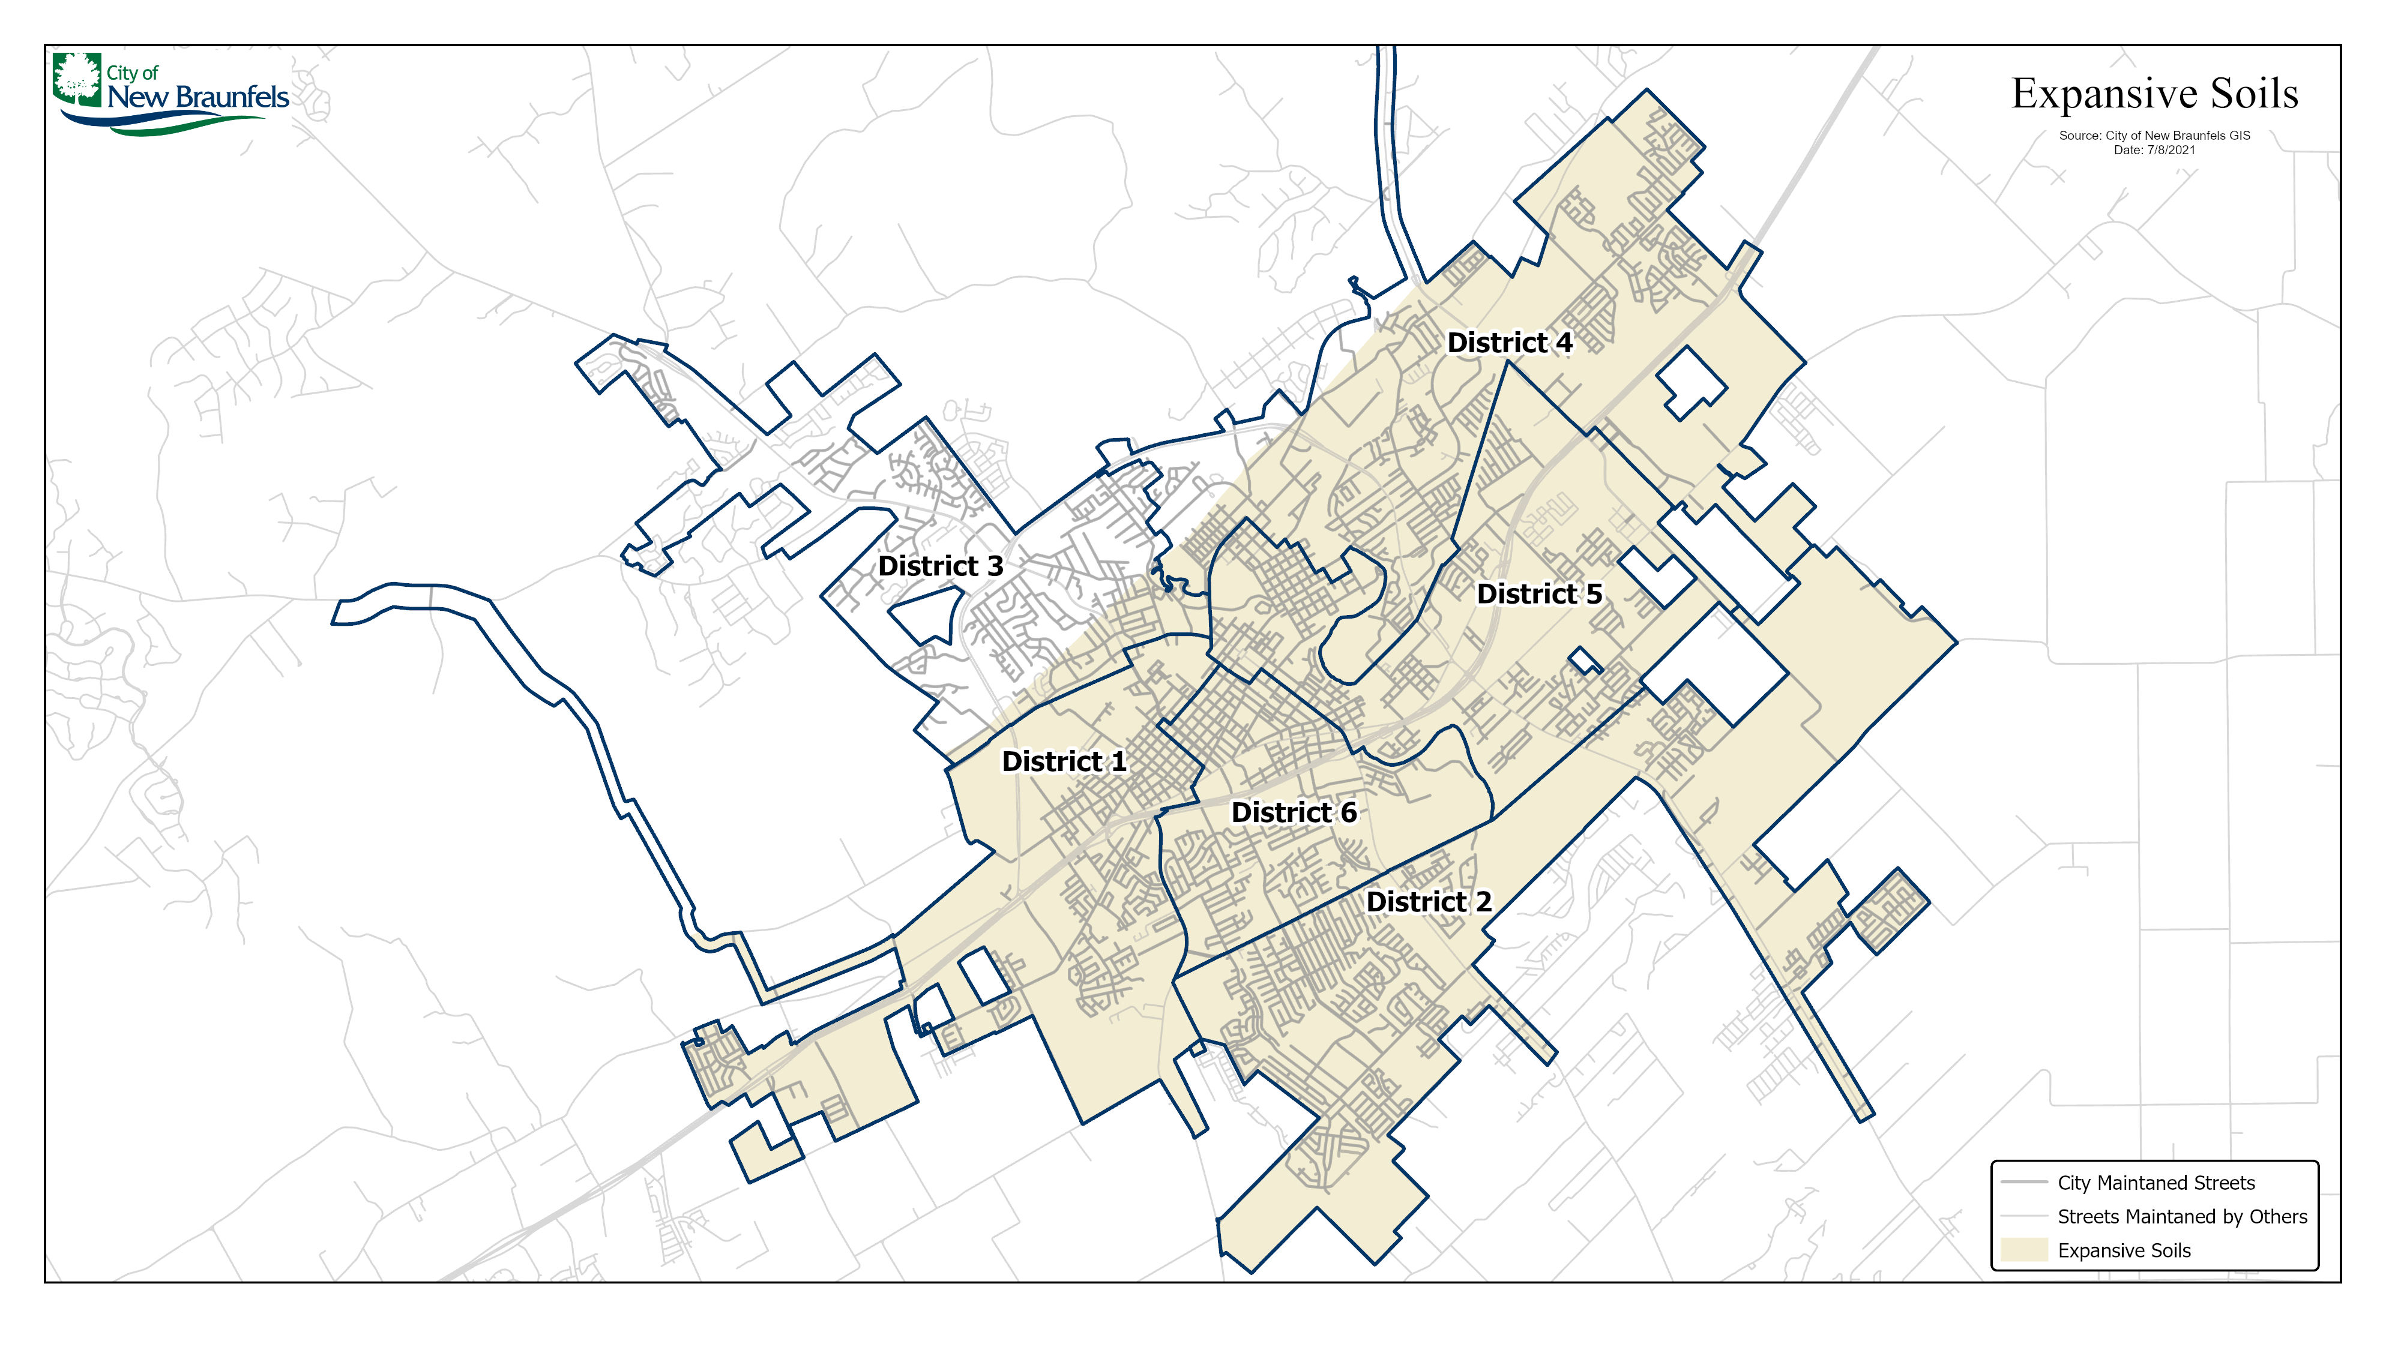

Slide 4
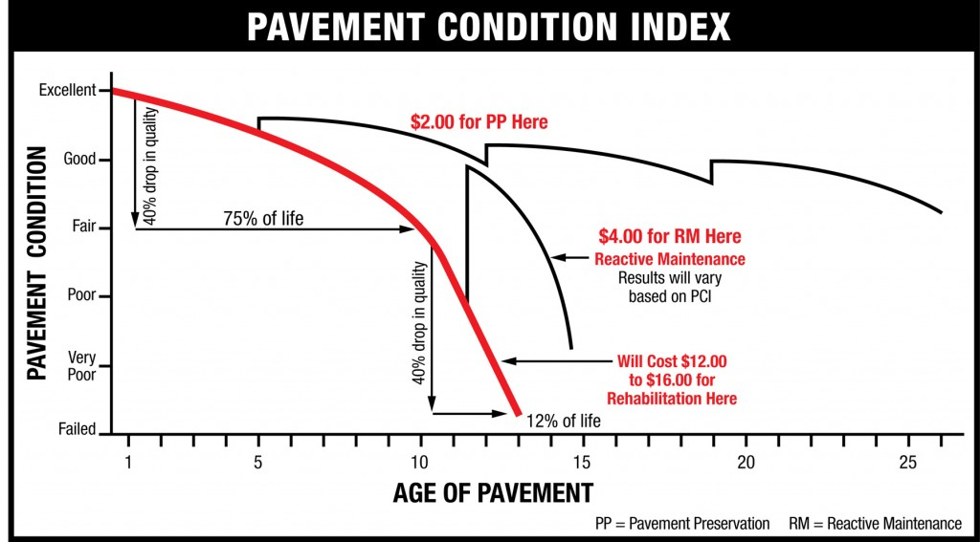
Pavement Condition Index

Slide 5
New Braunfels Street System
The City maintains 367 centerline miles containing 936 lane miles.
- 12 lane miles added in 2017
- 28 lane miles added in 2018
- 20 lane miles added in 2019
- 20 lane miles added in 2020
- 24 lane miles added in 2021
- 8 lane miles added for 2022
- 2 lane miles so far added for 2023

Slide 6
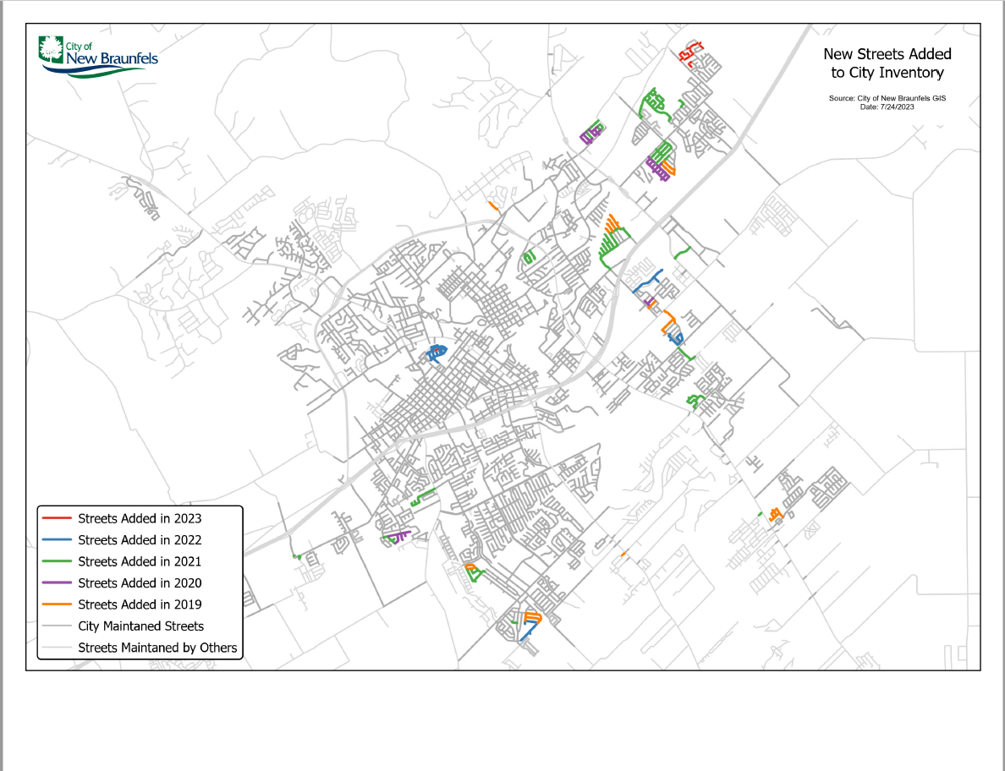

Slide 7
Maintenance Strategies
Preventative Maintenance
Crack Seal
Potholes, Patching and NBU Repairs
Surface Repairs
Level-Up and Thin Overlay – 1” Hot Mix Asphalt (HMA)
Micro Surfacing – 1/4” HMA
Mill and Overlay - mill 2” of the existing surface HMA and overlay
Rehabilitation
Mill or pulverize asphalt surface, stabilize subgrade, add base material and final 2” HMA surface matt

Slide 8
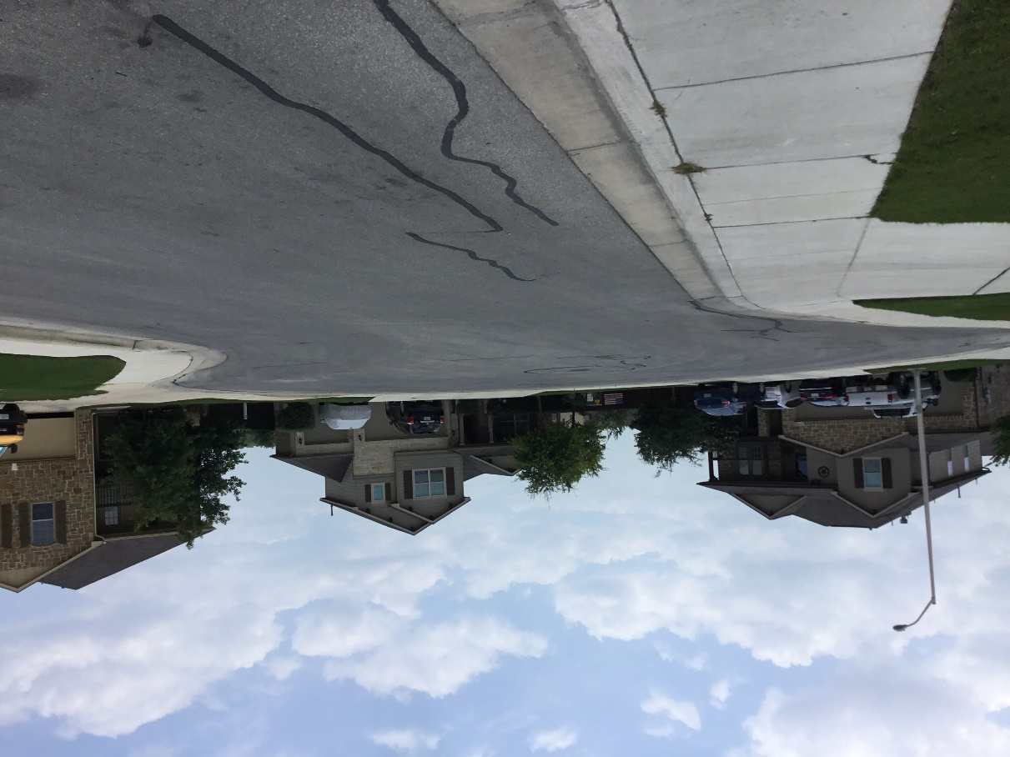
Functional Classifications
Local Street
Most common type of street in a city and provides direct access to adjacent properties. Carries no thru movement and parking is allowed.
Design speed: 20 – 30 mph

Slide 9
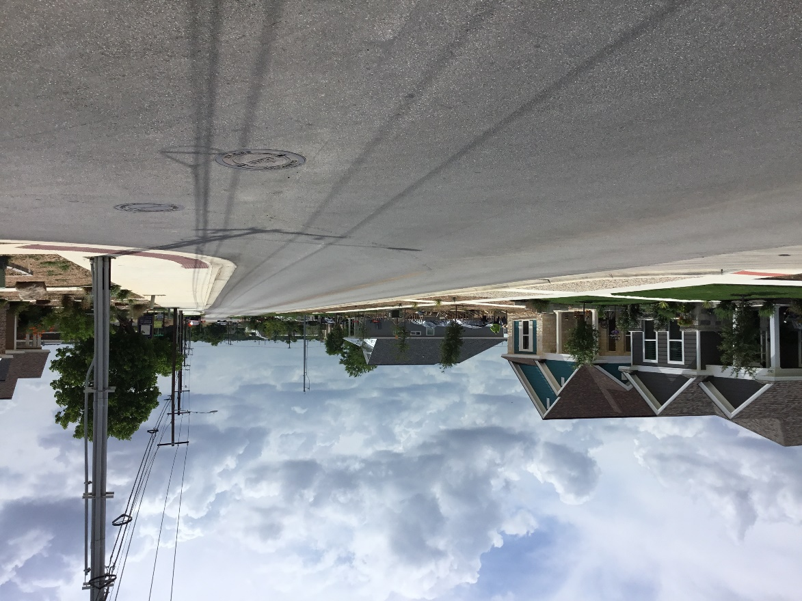
Functional Classifications
Collector Street
Street with a balance between access and mobility with parking allowed.
Design speed: 30 – 40 mph.
Example: Hanz Drive

Slide 10
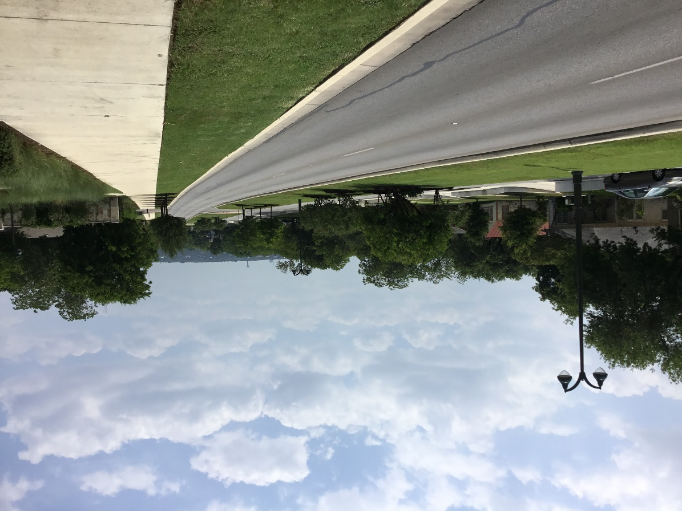
Functional Classifications
Arterial Street
Provide the most direct path of mobility for longer distances. Are typically much wider with more lanes and no parking.
Design speed: 45 – 50 mph.
Example: Walnut Avenue

Slide 11
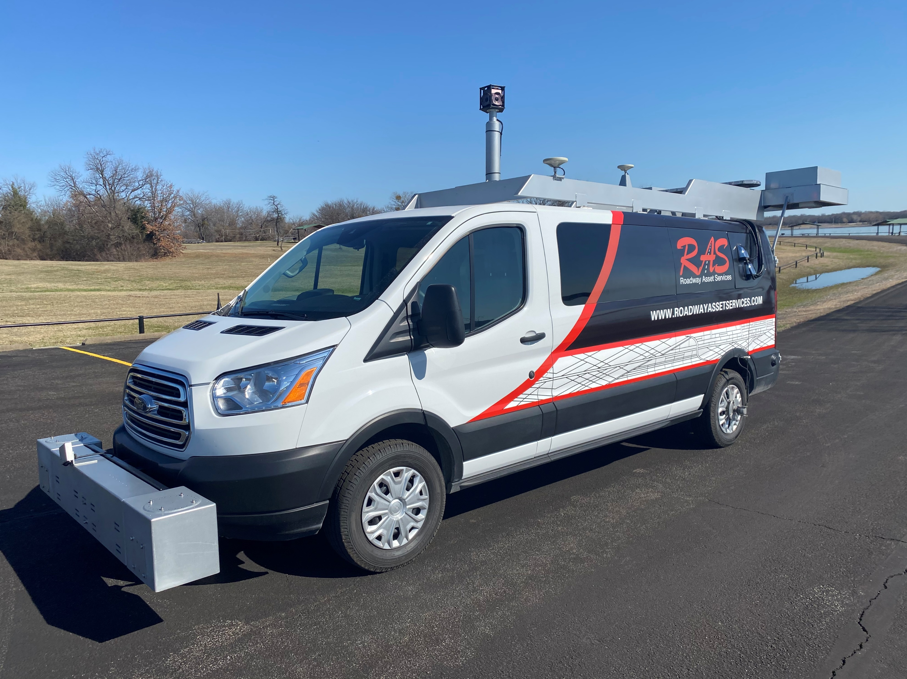
Street Plan Determination
Pavement Management Software System
  Inventory the pavement Overall Condition Index (OCI) from 1-100 (1 = worst)
  Recommendations from Cartegraph
Field Verification
  City staff visually inspects streets
Traffic Utilization
  Types of Streets (ex. Collector)

Slide 12
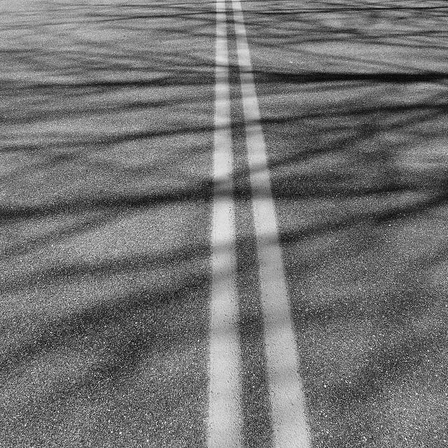
Street Plan Determination
Coordination with Utilities
Timing our repairs with planned utility street cuts and improvements
Appropriate Maintenance and Repair Strategies
6) Bond Project
7) Citizen Input
  During the year
  Public Outreach
8) City Council Approval

Slide 13
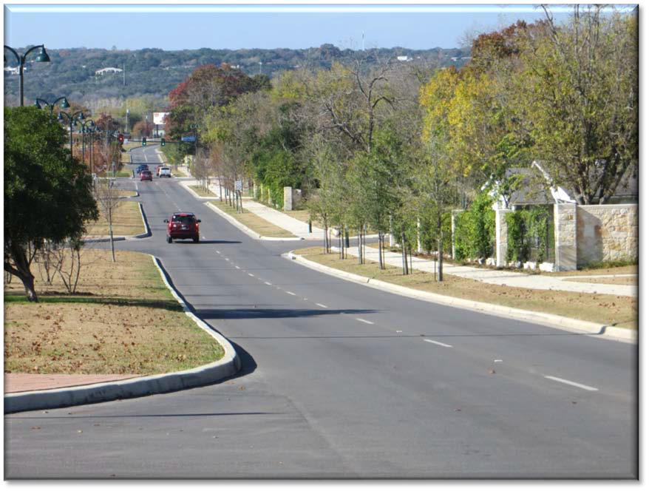
Overall Condition Index: 100
Considered excellent
Includes newly constructed or recently overlaid streets

Slide 14
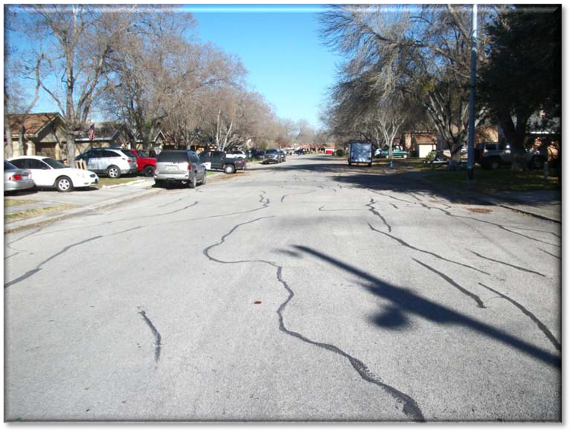
Overall Condition Index: 79
Considered good to very good and in structurally sound condition
Initial signs of aging, such as longitudinal and transverse cracking, slight raveling and an occasional pothole requiring patching

Slide 15
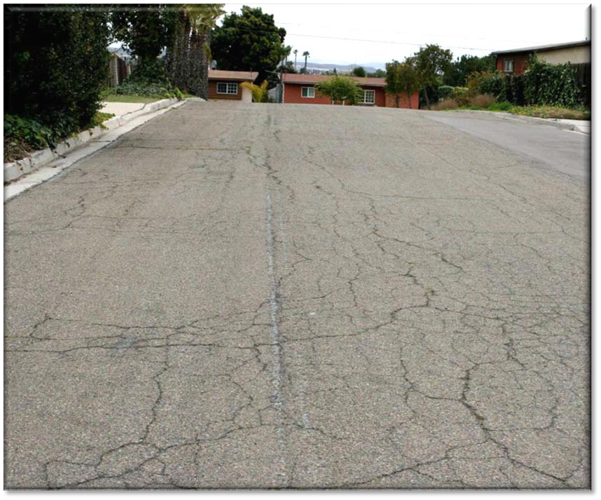
Overall Condition Index: 59
Considered in average condition
Roads show signs of needing resurfacing
Over 50% of the surface has block cracking
Streets in this condition could require rehabilitation

Slide 16
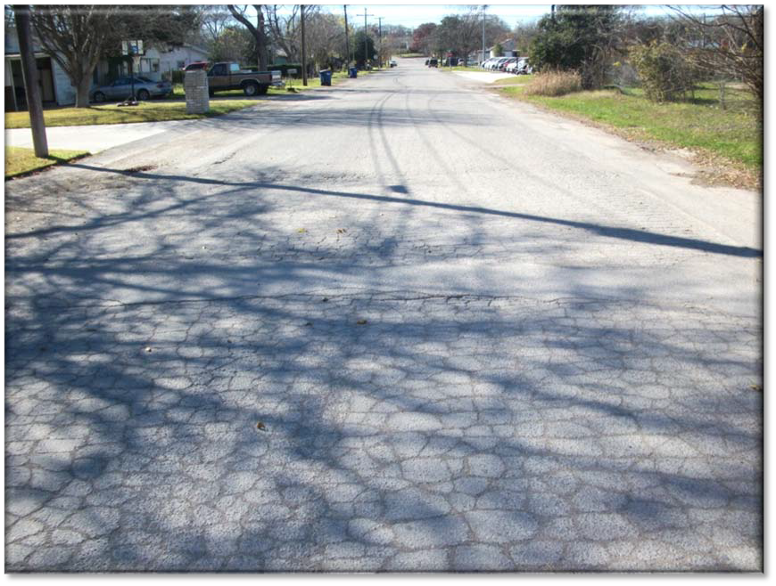
Overall Condition Index: 39
Considered fair
Could require rehabilitation or reconstruction

Slide 17
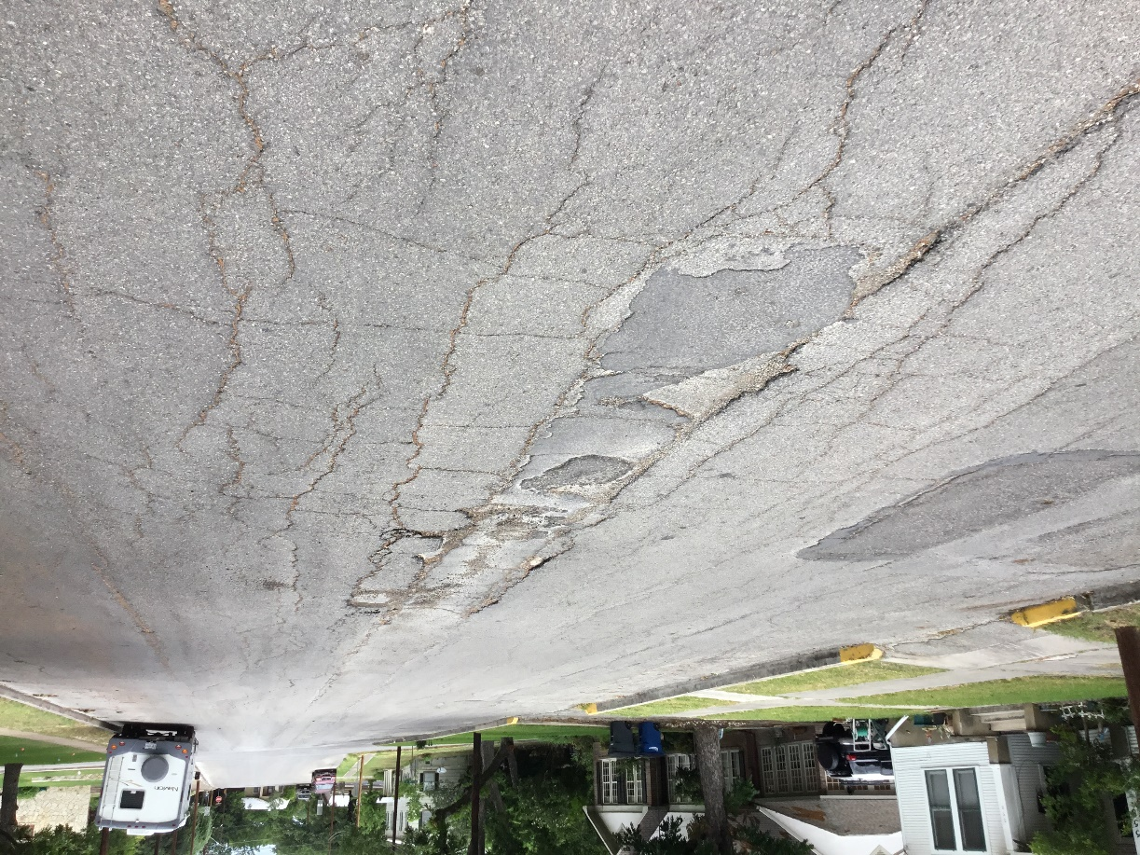
Overall Condition Index: 19
Condition is considered poor to failed
Requires reconstruction of base and surface

Slide 18
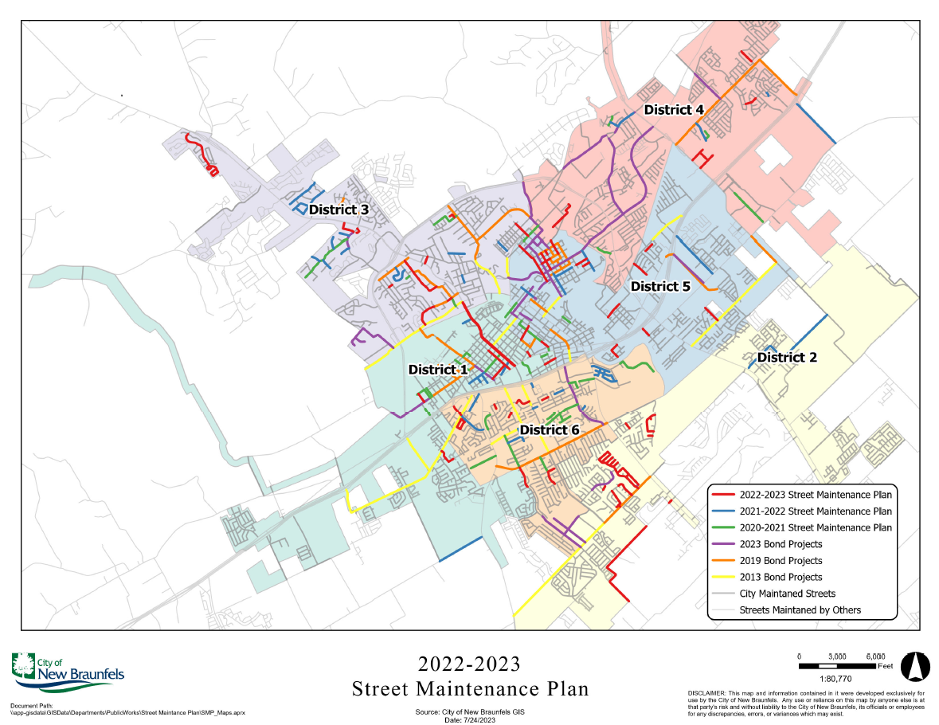

Slide 19
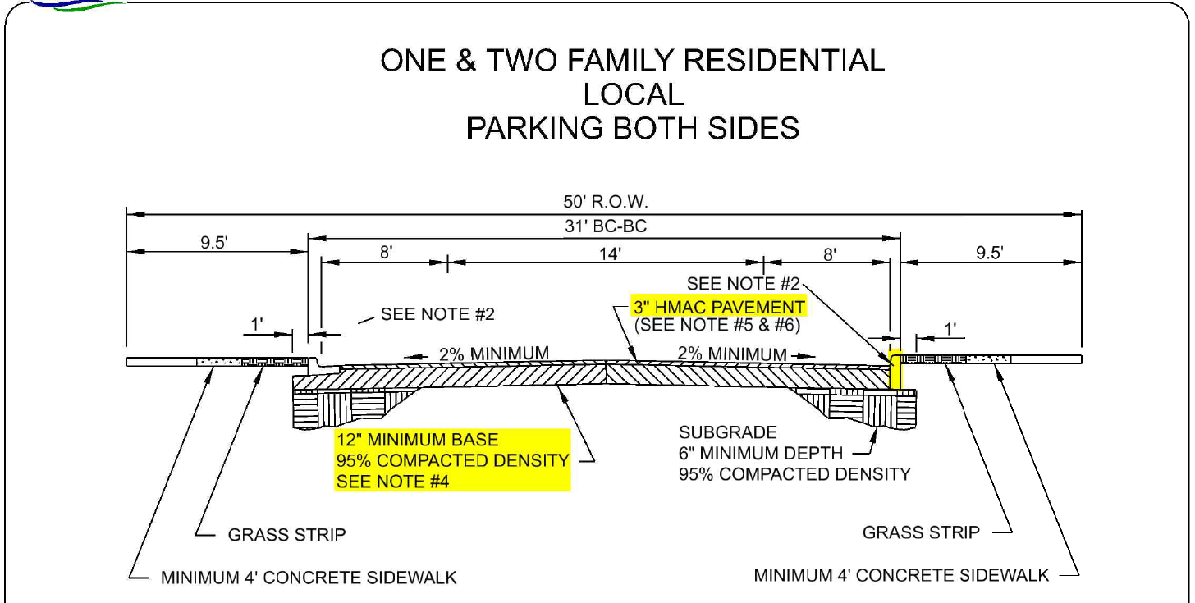

Slide 20
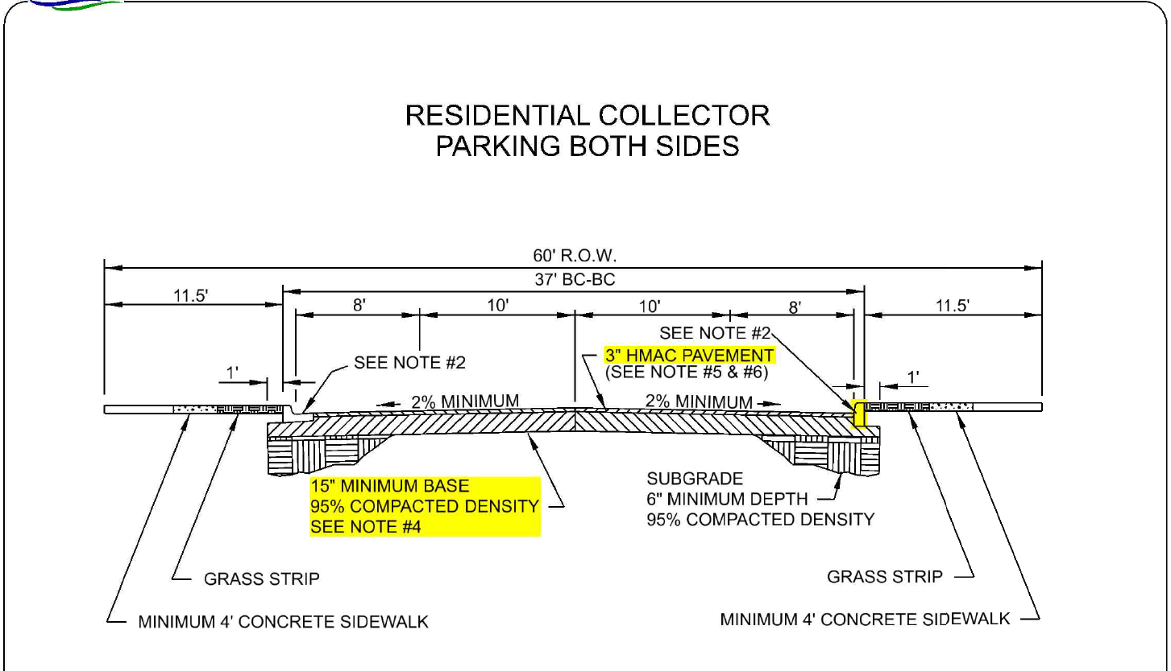

Slide 21
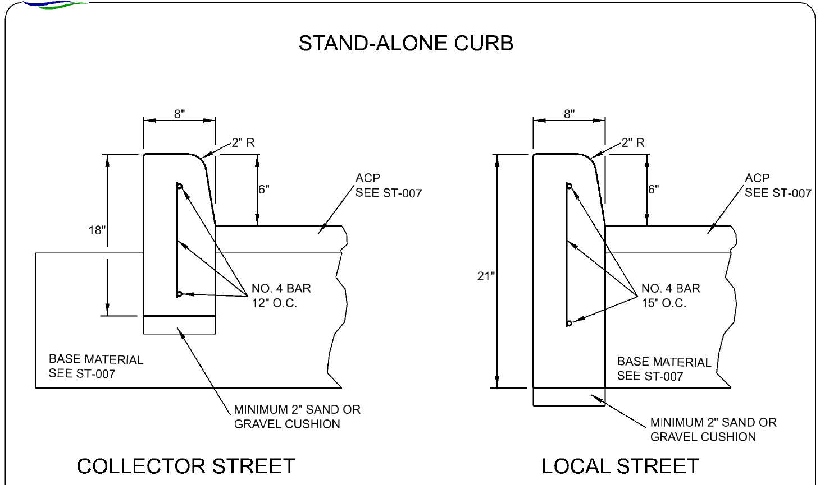

Slide 22
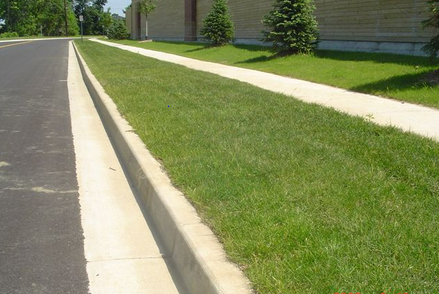

Slide 23
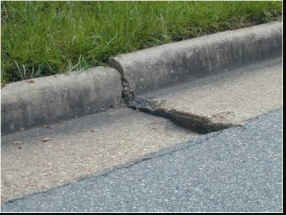

Slide 24
Next Steps
Receive Public input (July 25th meeting and online survey till
Aug 4th)
Evaluate to develop the 2023-2024 proposed street maintenance plan
Present to City Council for approval in Fall 2023

Slide 25
Links
Tonight’s Meeting - Online Survey:
www.newbraunfels.gov/streetsurvey
Submitting a Pavement Concern:
https://newbraunfels.gov/284/Streets-Drainage
Viewing OCI Map and Road Closure Map:
https://newbraunfels.gov/1847/Pavement-Management-Program

