Slide 1
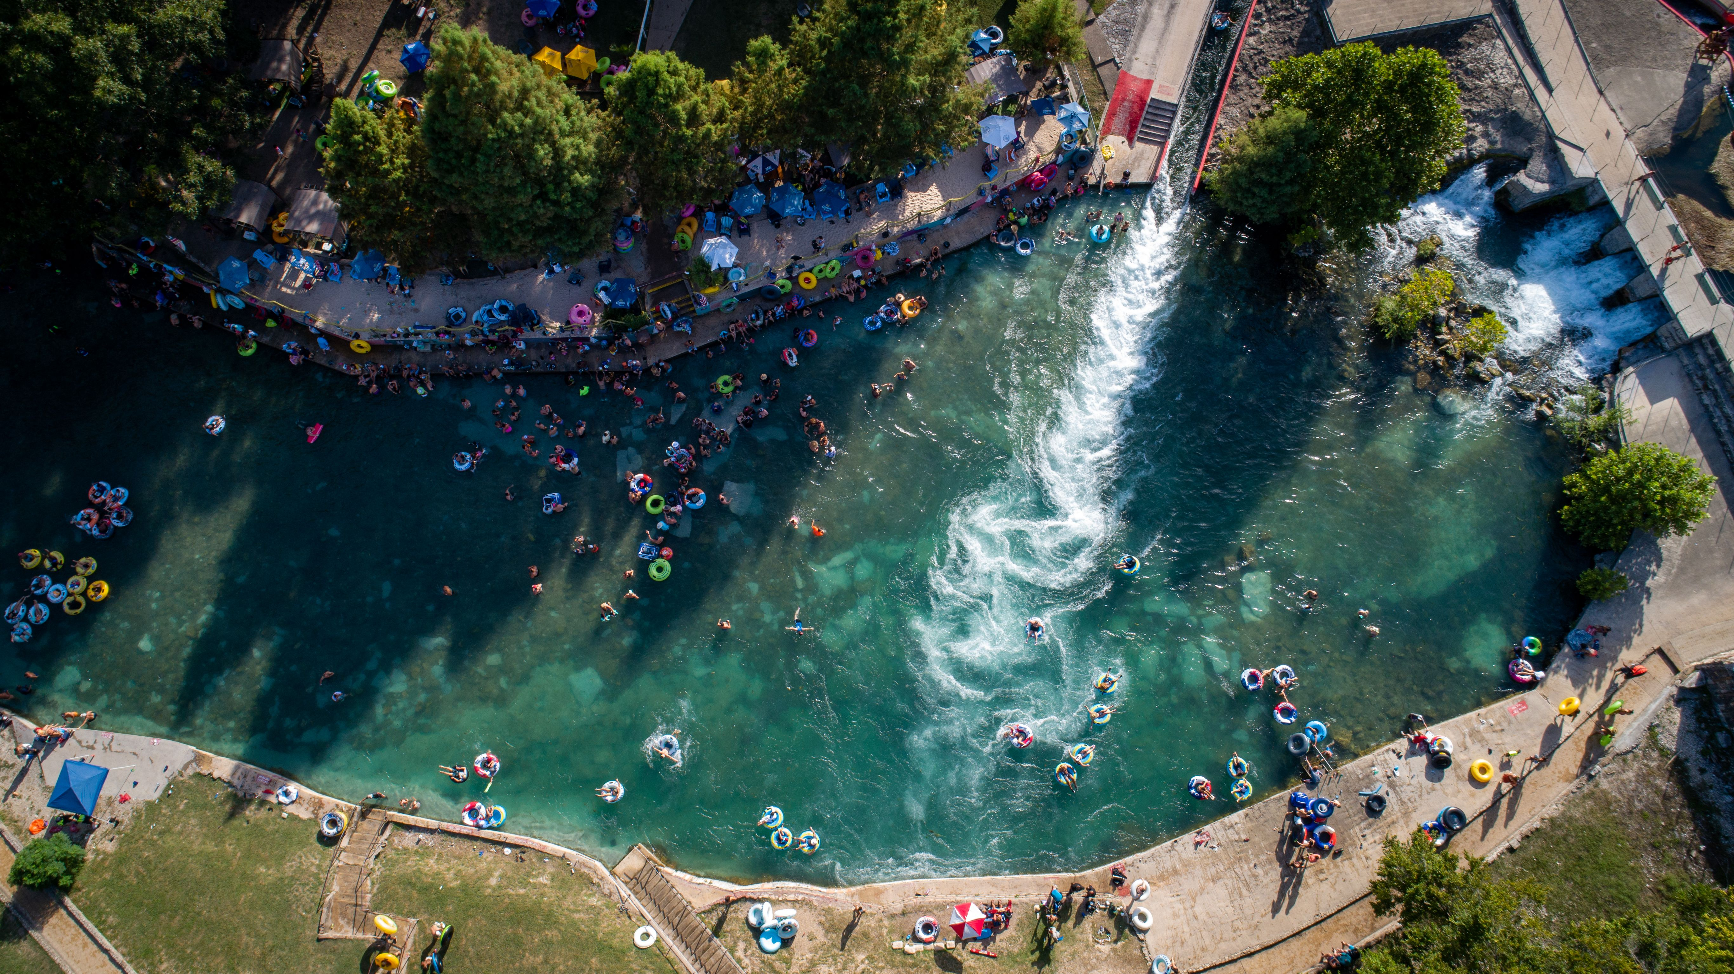

2023 End of River Season Summary

Slide 2

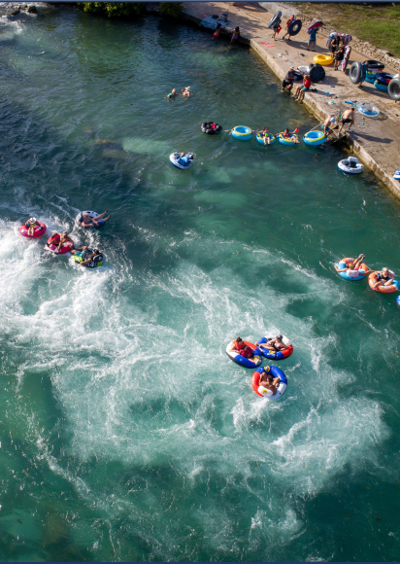
2023 Season in Review
Tubing in New Braunfels is a resilient form of recreation, even in drought conditions
There was an increase in River Management Fees collected in comparison to the last few years
Parking revenue collected was a new high for the season
Parking and litter totals point to higher weekday use
There is a need for re-education on the Disposable Container Ban

Slide 3
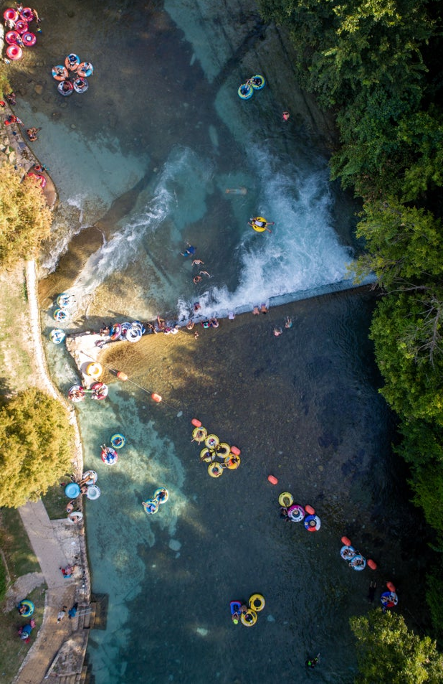
2023 Season in Review Continued
It was hot and dry- again!
Triple digit temperatures most of the summer
No river closures
The float was long- over 4 hours in July
There were no staging days for the Comal River
Low river flow brought new challenges from one weekend to the next
The free lifejacket program continues to see tremendous use

Slide 4
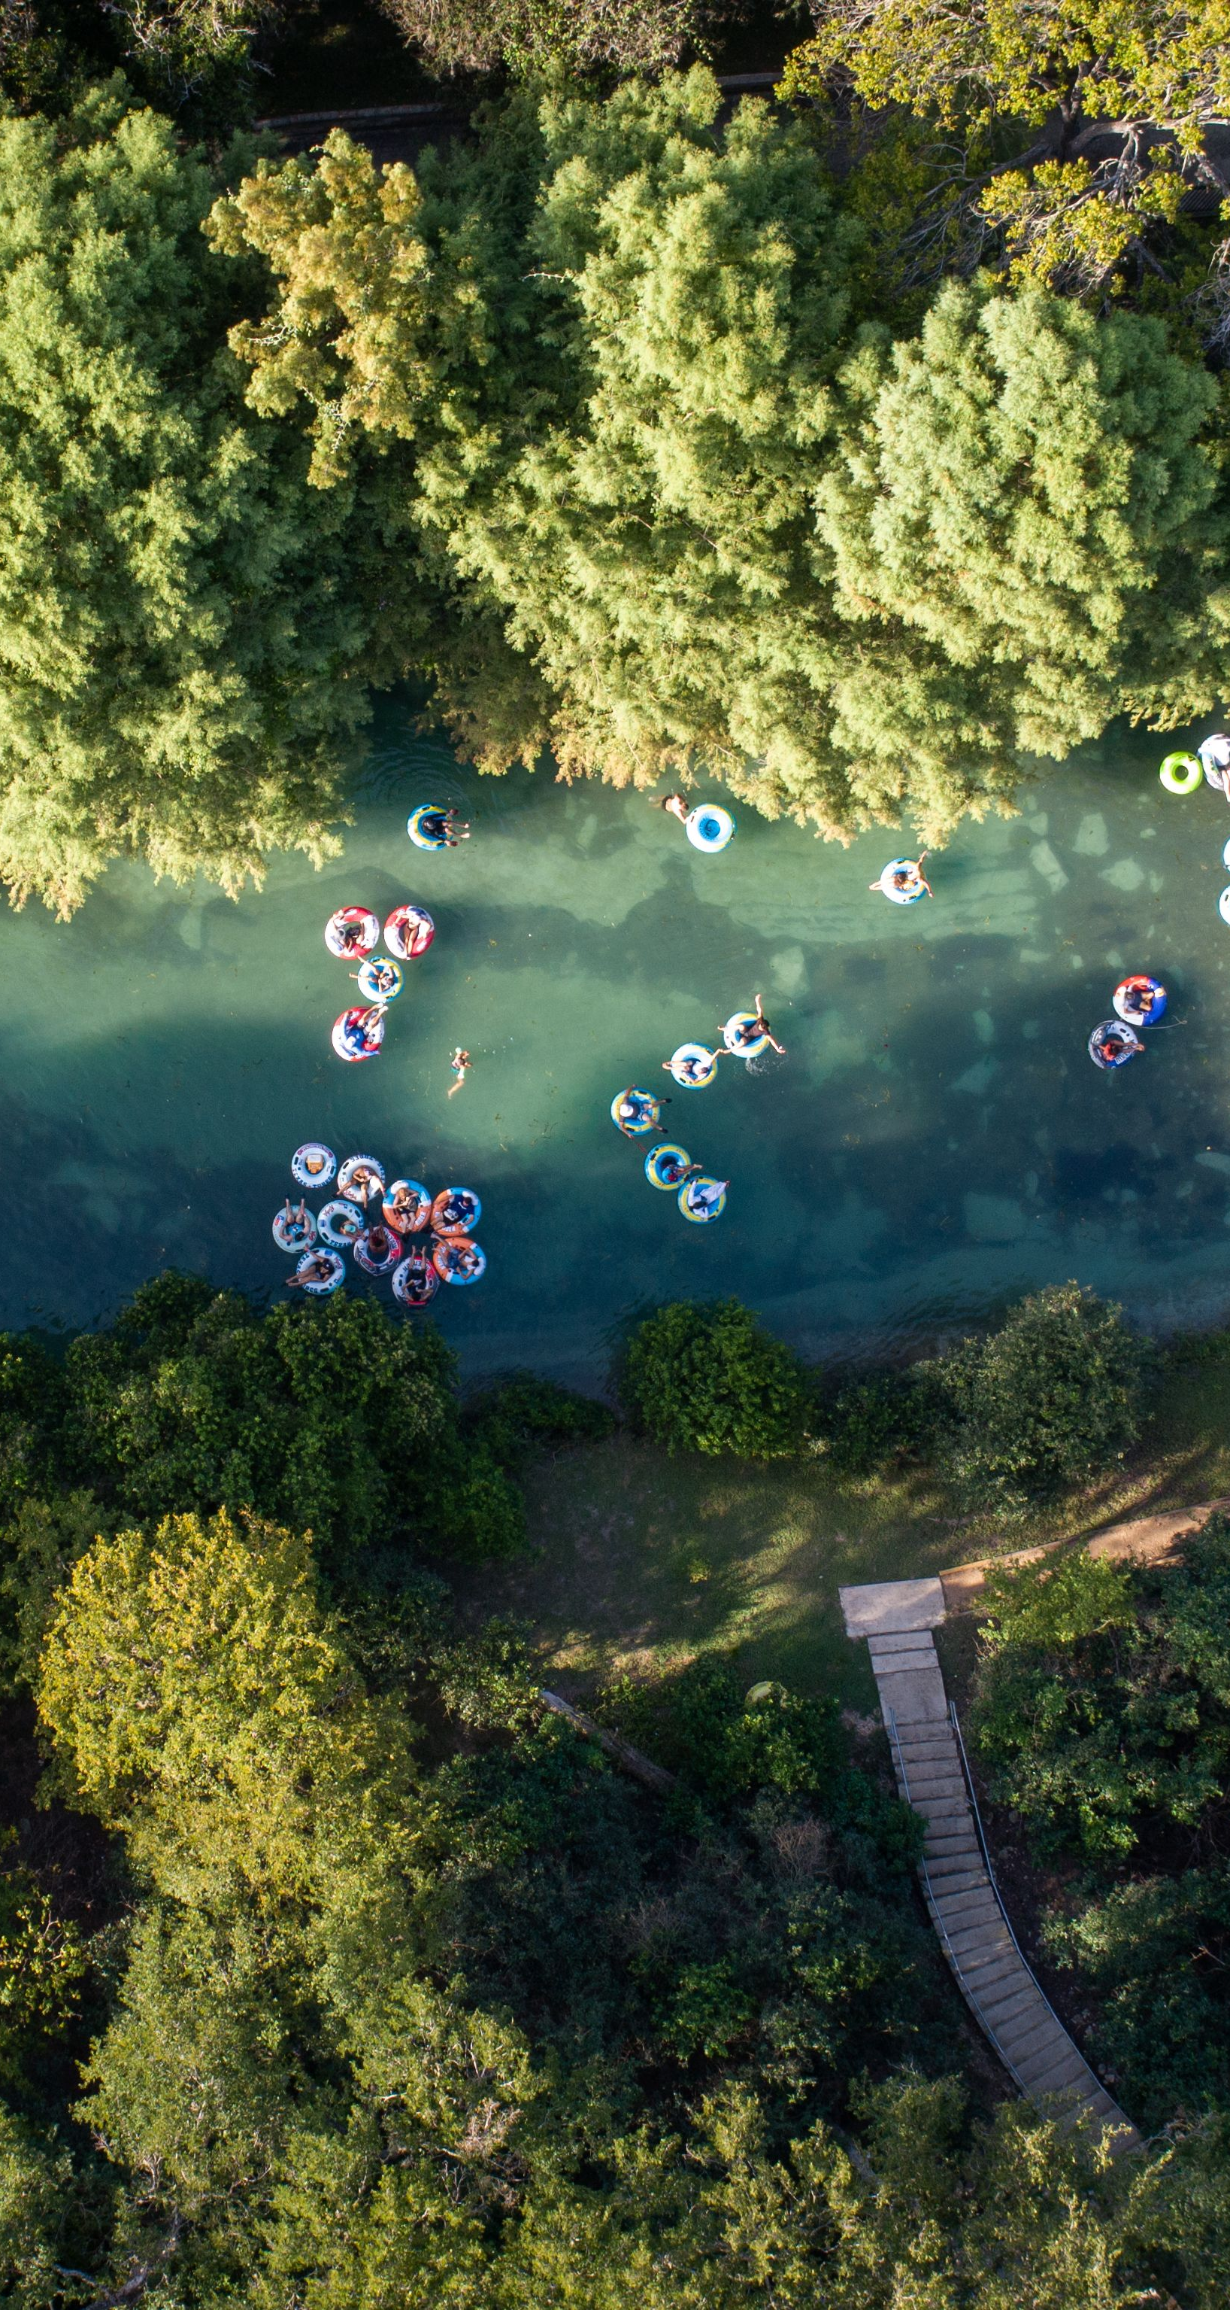
River Litter Totals
Litter collected in the rivers in New Braunfels
* 2023 totals are incomplete, including only March-September

Slide 5

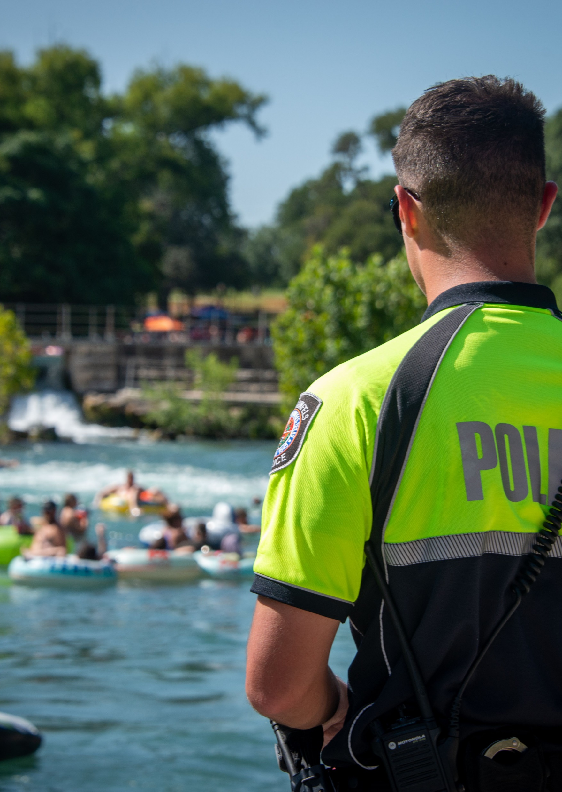
Compliance

Slide 6
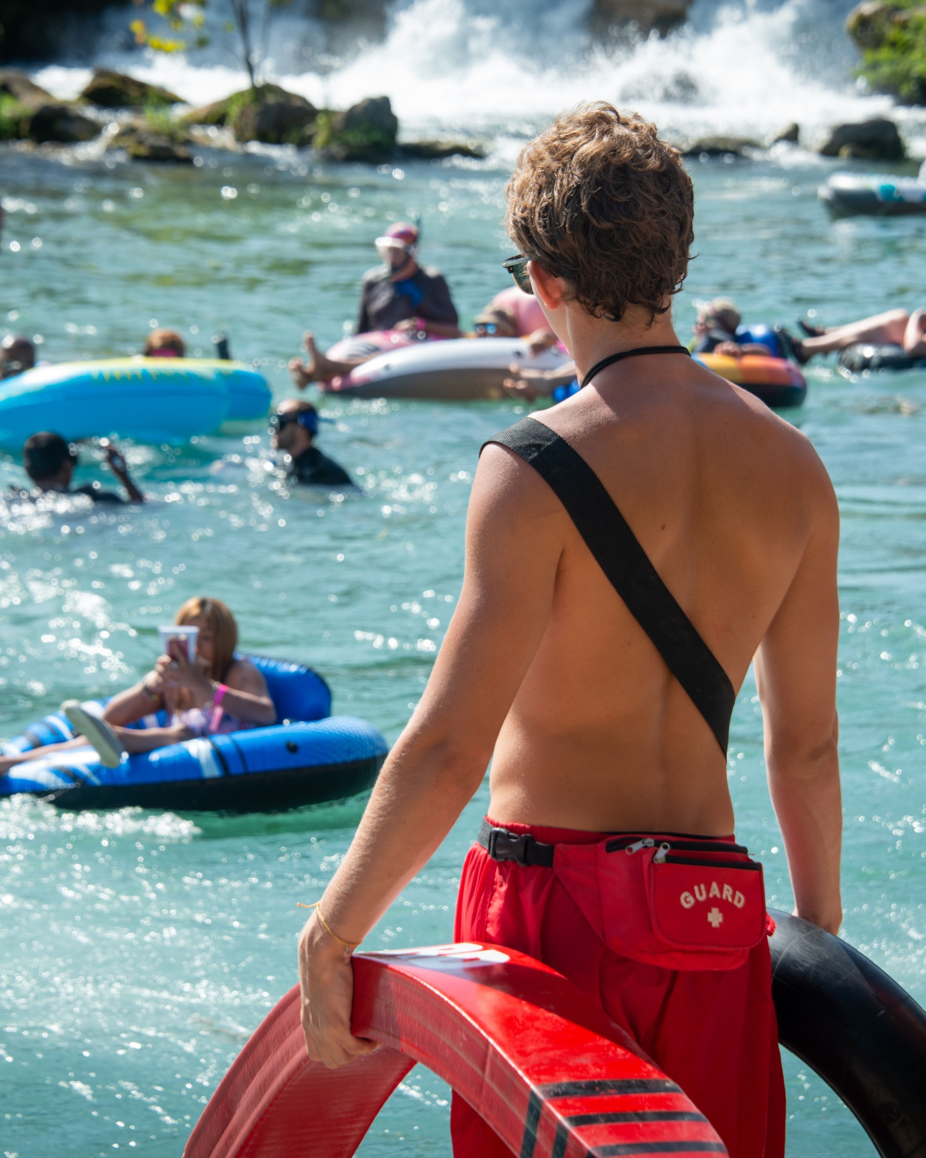
Lifeguard Activity
*Lifeguards were not at the Tube Chute August 19-20, 26-27, and September 2-4 due to low flow conditions.

Slide 7

Parking Revenue
Parking is the #1 source of revenue in the River Fund
5 paid parking lots, 4 are free for residents
No rain days
Parking revenue points to an increase in weekday visitation

Slide 8
River Management Fee
The River Management Fee is $2 per user on weekends and holidays from Memorial Day Weekend- Labor Day
Extra holiday collection day on July 3rd
22% of River Management Fees are collected by the City, and 78% are collected by River Outfitters

Slide 9
River Fund
Summary of Revenues and Expenditures

Slide 10

















Dos Rios Watershed Cleanup
^{7th} Annual Cleanup
October 14, 2023

Slide 11
River Advisory Committee & Upcoming Projects
Financial forecasting to ensure long-term solvency of the River Fund
Comal River Improvement Project- Last Public Exit
Comal River and Parks Sign Plan
Consider application for National Water Trail recognition for the Comal River
Consider Paid Parking at Guadalupe River Parks
Consider Park Hours at City Tube Chute Park
Direction for River Advisory Committee

Slide 12
Questions?

