Slide 1
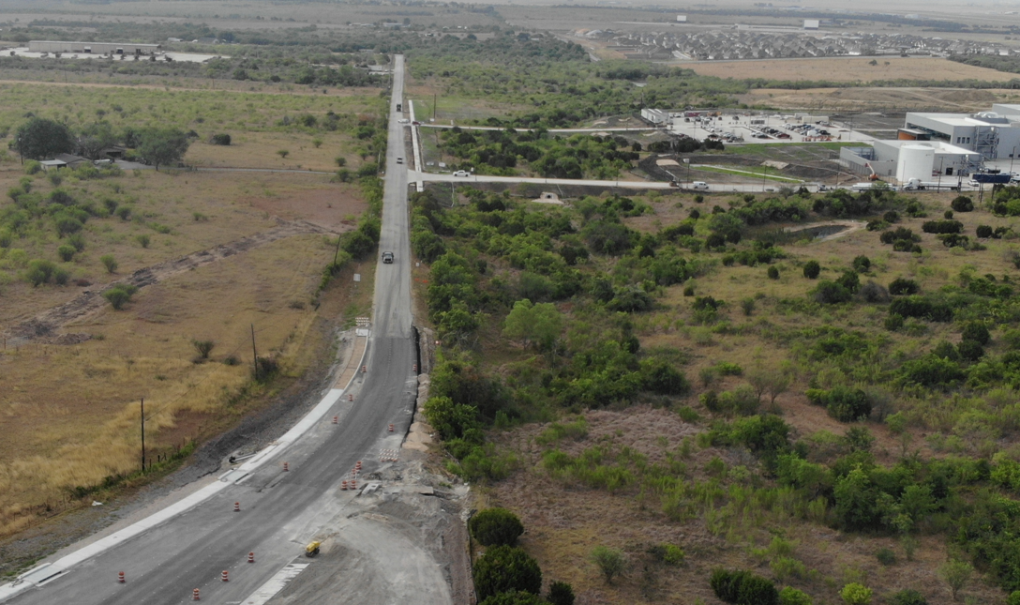

Kohlenberg Road Widening Project

Slide 2
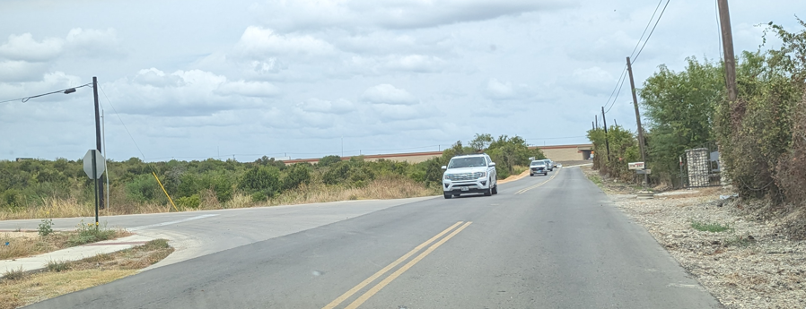
Project Highlights
Project Highlights
  Roadway widening & Realignment
  Traffic signal Upgrades
    FM 1101
  Provides a continuous shared use path and pedestrian facility
  Installation of underground storm sewer
  Utility upgrades and relocations

Slide 3
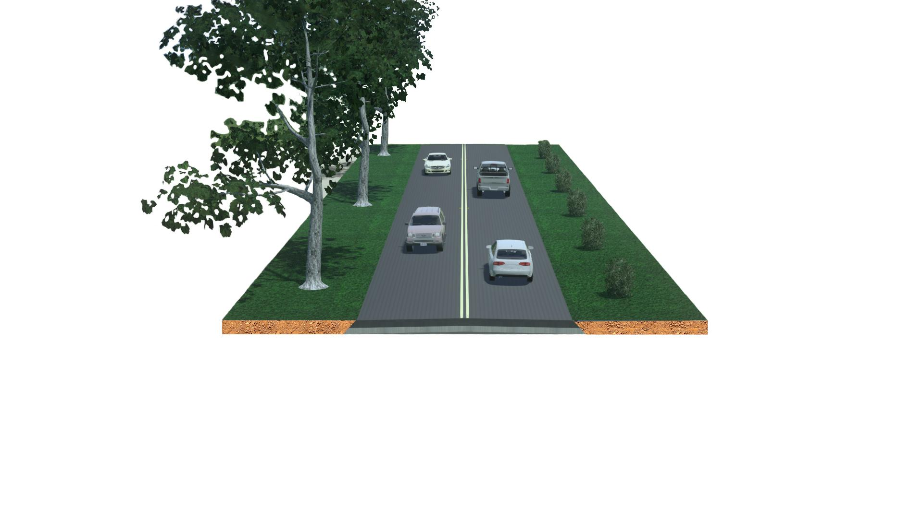
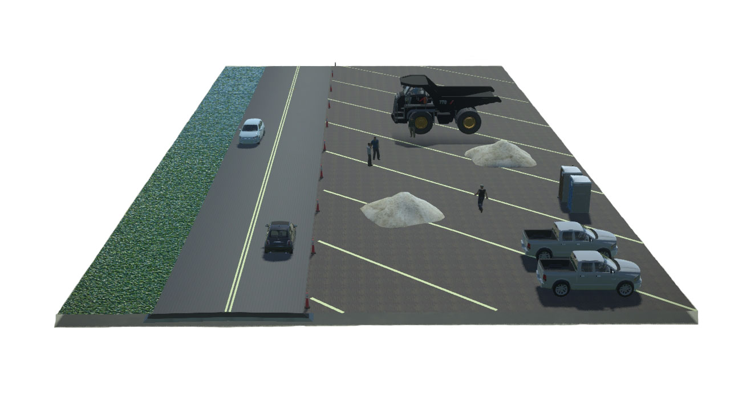
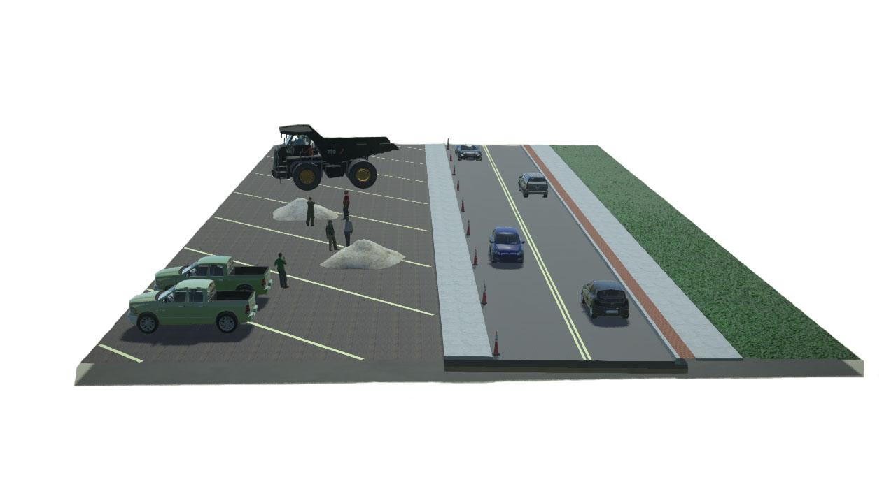
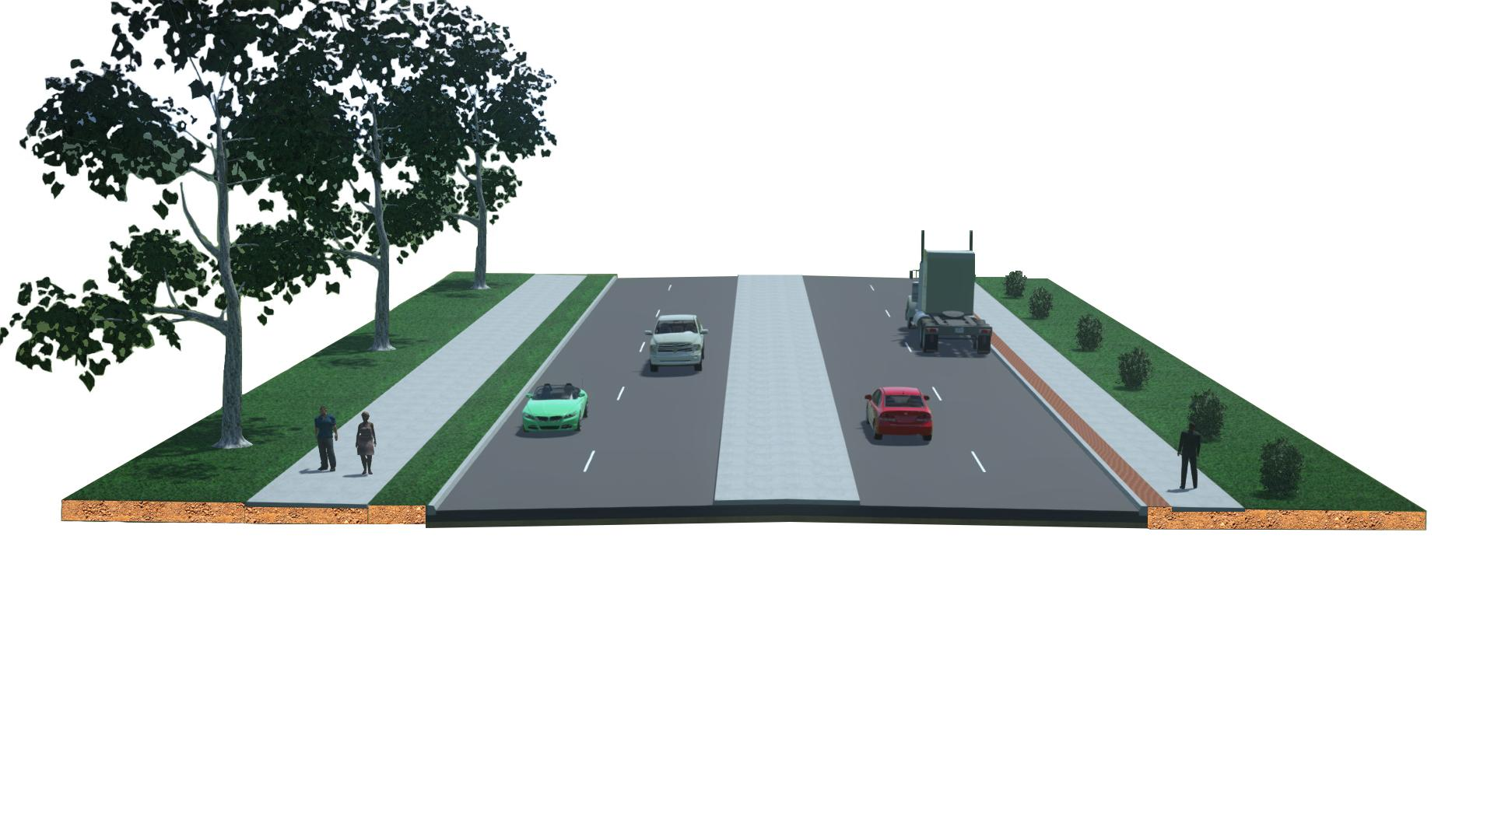
Construction Sequencing
Begin Construction
Construct Southbound Lanes
Construct Northbound Lanes
End Construction

Slide 4
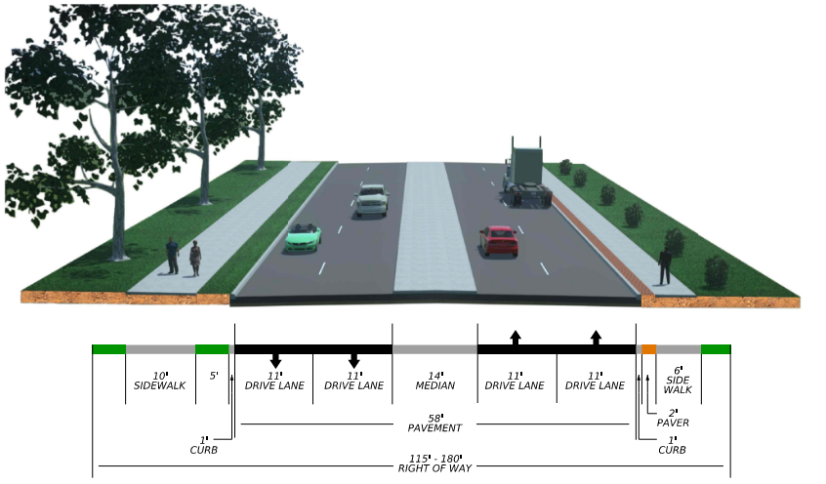
Proposed Kohlenberg Typical Section

Slide 5
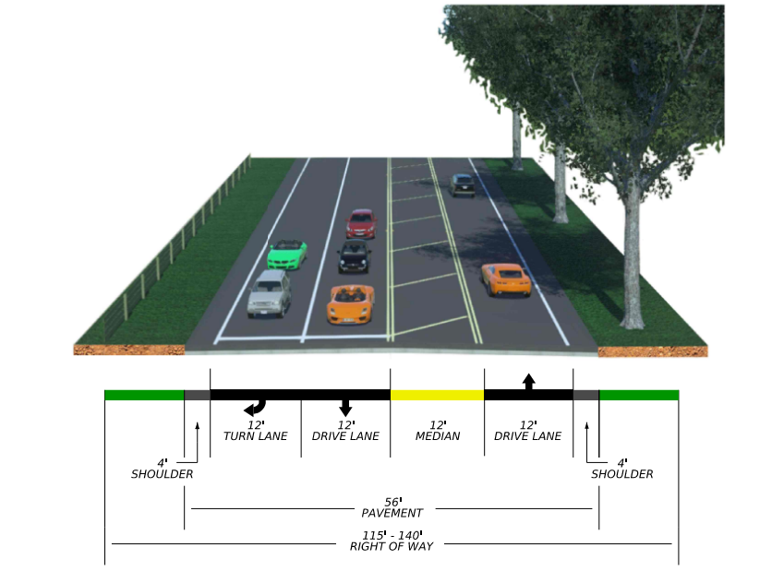
Proposed FM-1101 Typical Section

Slide 6
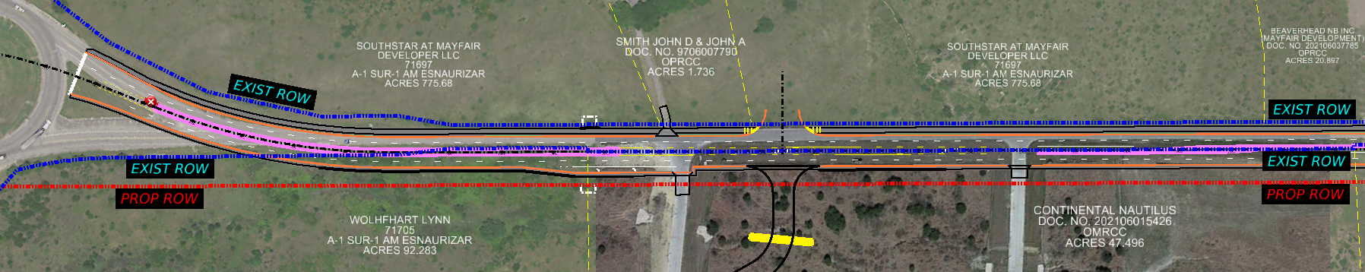
Right of Way Acquisition
LEGEND
EXIST ROW
EXISTING RIGHT-OF-WAY (ROW)
PROP ROW
PROPOSED RIGHT-OF-WAY (ROW)

Slide 7
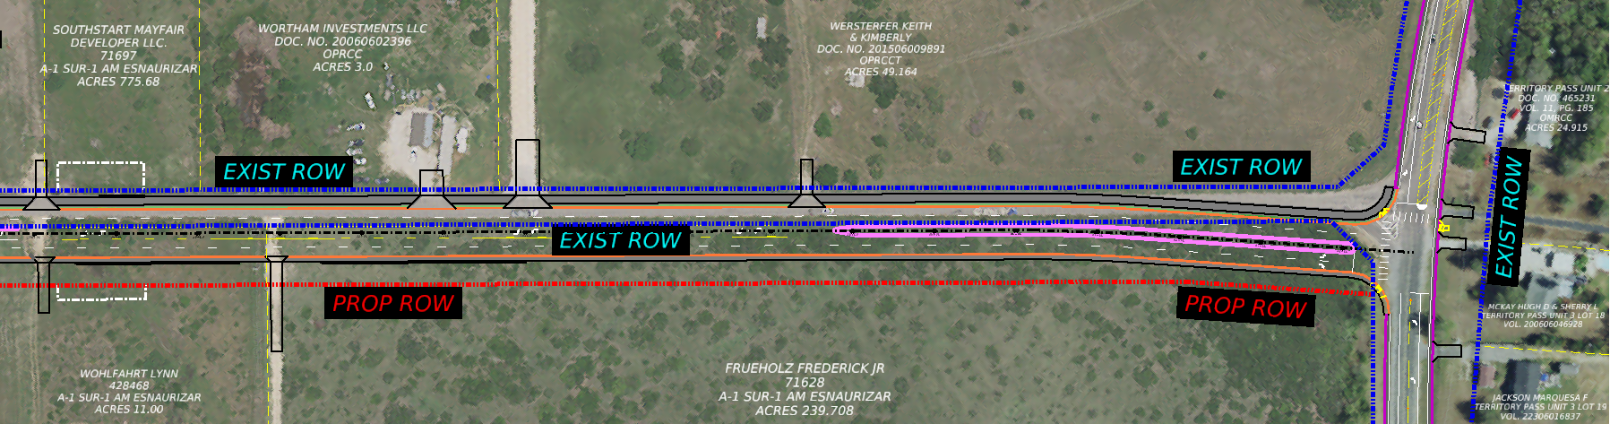
Right of way Acquisition
LEGEND
EXIST ROW
EXISTING RIGHT-OF-WAY (ROW)
PROP ROW
PROPOSED RIGHT-OF-WAY (ROW)

Slide 8



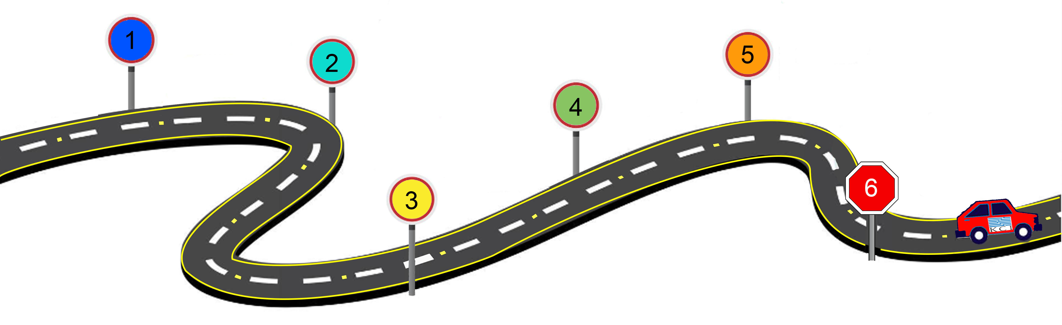




Project Timeline
2023-2024
December 2024
Late 2024- Mid 2025
Mid 2025- Late 2026
Late 2026
Late 2029
1
2
3
4
5
6
Current Milestone
Schematic Design
Design Phase
ROW/Easement Acquisition
Utility Relocation
Begin Construction
End Construction

