Slide 1
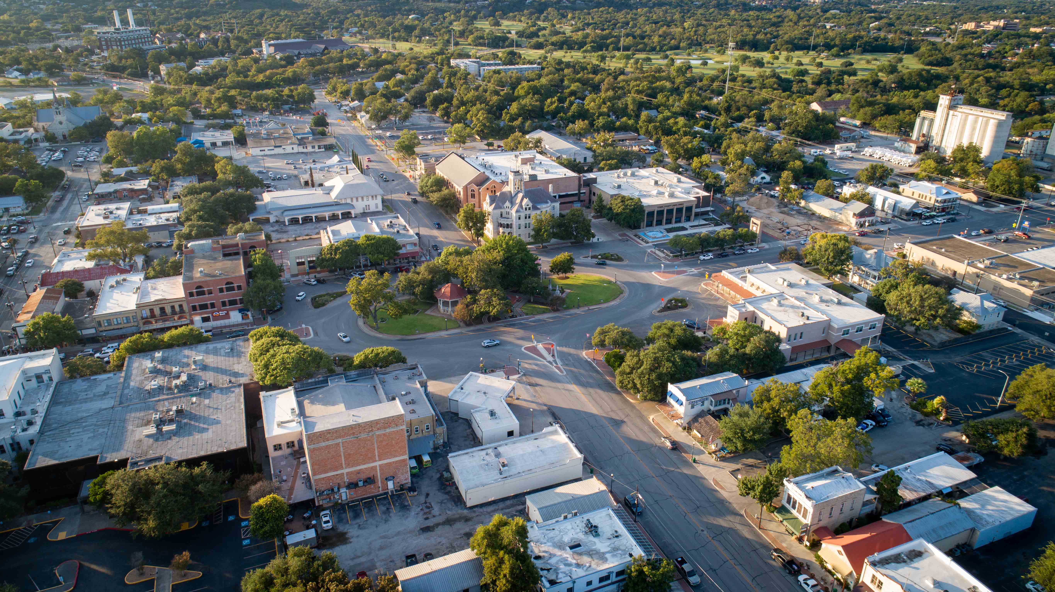

Barbarosa Road / Saur Lane Widening
2022 Bond Program
NB 22-167

Slide 2
Project Location

Slide 3
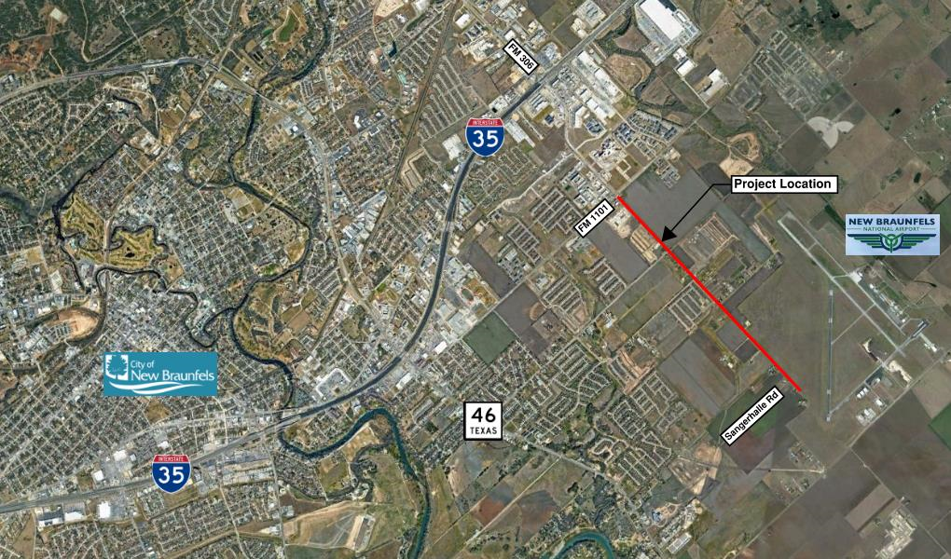
Barbarosa Rd/Saur Ln
Existing Conditions:
2-lane undivided major urban collector
Limited, discontinuous pedestrian facilities
2 signalized intersections
Annual Average Daily Traffic: 11,400 veh/day (2030)
Major thoroughfare between IH 35 and FM 758
Facility serves:
Single and Multi-family Residential
New Braunfels National Airport
Commercial/Retail
Hospital & Retail Shopping center (2027)

Slide 4
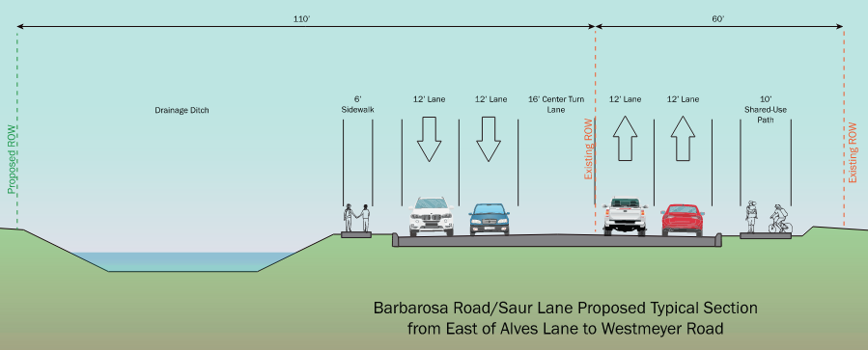
Barbarosa Rd/Saur Ln
Proposed Conditions:
4-lane major urban collector
Continuous bike and pedestrian facilities
Annual Average Daily Traffic: 18,200 veh/day (2050)
Key Features
4 lane facility with 12’ lanes
9 new left turn lanes, 4 new right turn lanes
New storm sewer
14’ wide medians or shared left turn lanes
10’ wide SUP and 6’ sidewalks with green space

Slide 5
Construction Phasing

Slide 6
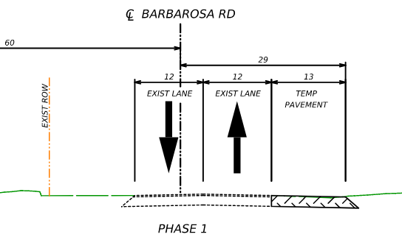
Construction: Phase 1
Existing Conditions
Common Lanes: 12’ wide
Shoulder Varies: 0’ - 4’ wide
Maintaining current day traffic patterns
Construction Phase 1:
Construct temporary pavement
No shoulder on eastbound traffic
No traffic shift
Common lane widths remain 12’

Slide 7
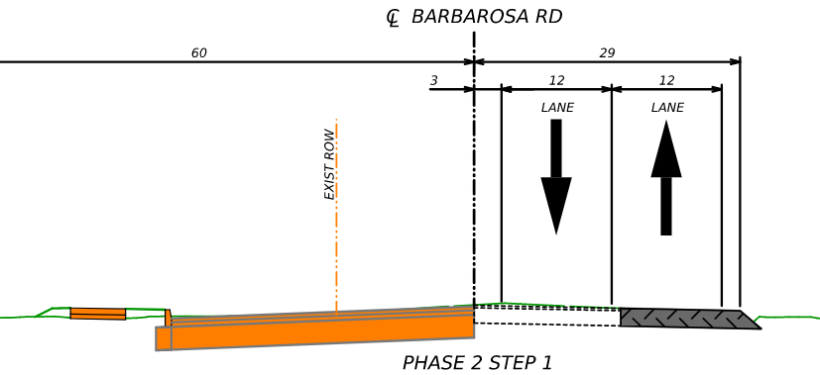
Construction: Phase 2
Construction Phase 2:
Shift traffic
Erect low profile concrete barrier
Lanes reduced to 11’ wide in each direction
Construction begins on westbound lanes, curb and gutter, and sidewalks

Slide 8
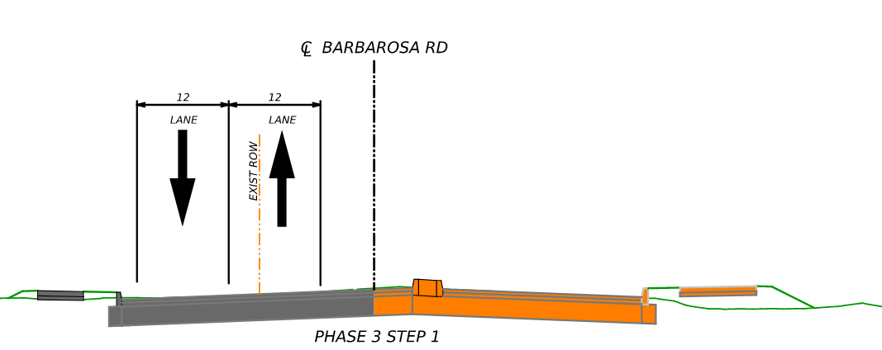
Construction: Phase 3
Construction Phase 3:
Shift traffic on to newly constructed pavement
Erect low profile concrete barrier
Lanes remain 11’ wide in each direction
Construction begins on eastbound lanes, curb and gutter, and sidewalks

Slide 9
Environmental Impacts

Slide 10
NATIONAL ENVIRONMENTAL POLICY ACT (NEPA)
National Environmental Policy Act (NEPA) Assignment to the Texas Department of Transportation
The environmental review, consultation, and other actions required by applicable Federal environmental laws for this project are being, or have been, carried out by TxDOT pursuant to 23 U.S.C. 327 and a Memorandum of Understanding dated December 9, 2019, and executed by FHWA and TxDOT.

Slide 11
Environmental Considerations
Natural Resources
Land Use
Air Quality
Noise
Water Quality
Wetlands
Vegetation and Wildlife
Geology, Farmlands, and Soils
Threatened and Endangered Species
Cultural Resources
Archaeological Resources
Historical Non-archaeological
Section 4(f)/6(f) Properties
Social Resources
Pedestrian and Bicycle
Economic

Slide 12
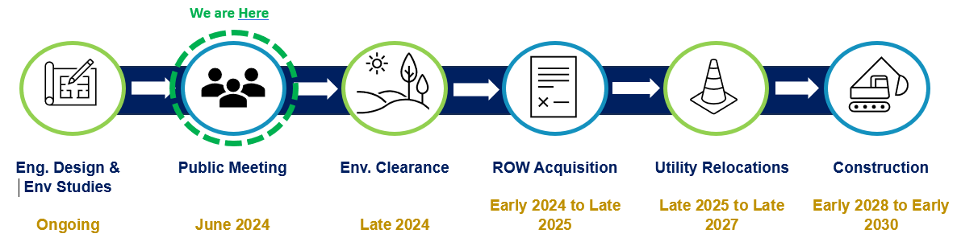
Project Timeline
*Dates subject to change

